Slide 1



Employee Data Analysis Internship Project
Data Analyst : Nilesh Thorat

Slide 2
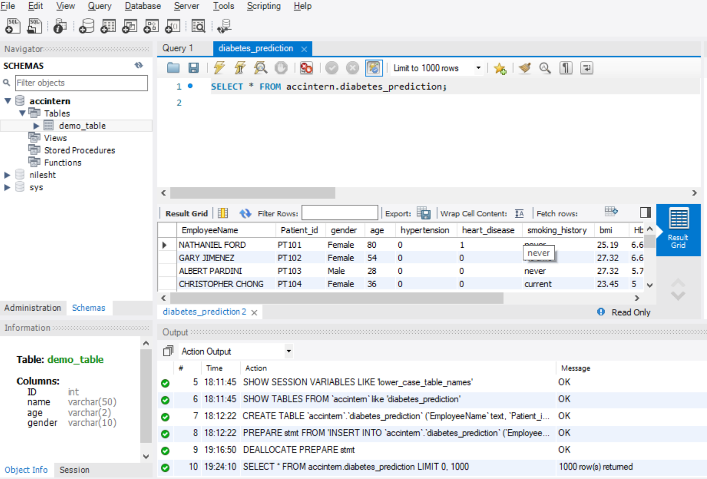
Import of Data Diabetes_prediction in MySQL
Please find the below Screenshot of SQL query details performed by using MySQL

Slide 3
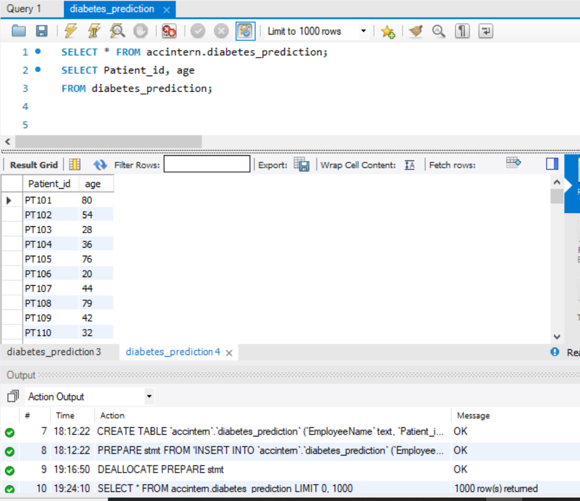
Task-1 : Retrieve the Patient_id and ages of all patients.
Please find the below Screenshot of SQL query details performed by using MySQL

Slide 4
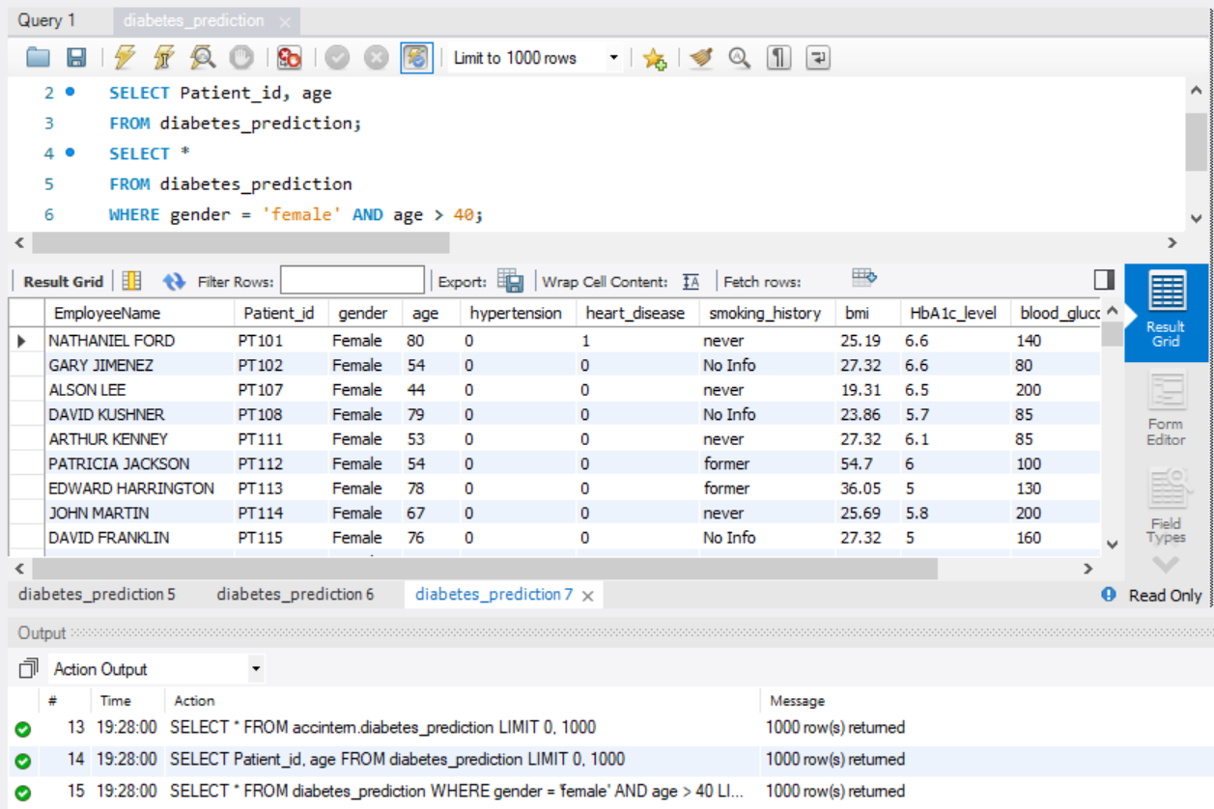
Task-2 : Select all female patients who are older than 40
Please find the below Screenshot of SQL query details performed by using MySQL

Slide 5
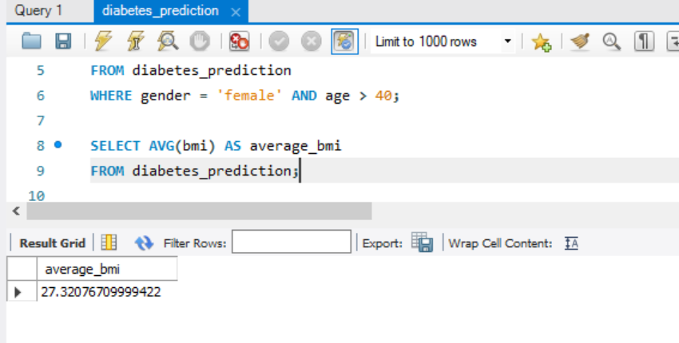
Task- 3 : Calculate the average BMI of patients.
Please find the below Screenshot of SQL query details performed by using MySQL

Slide 6
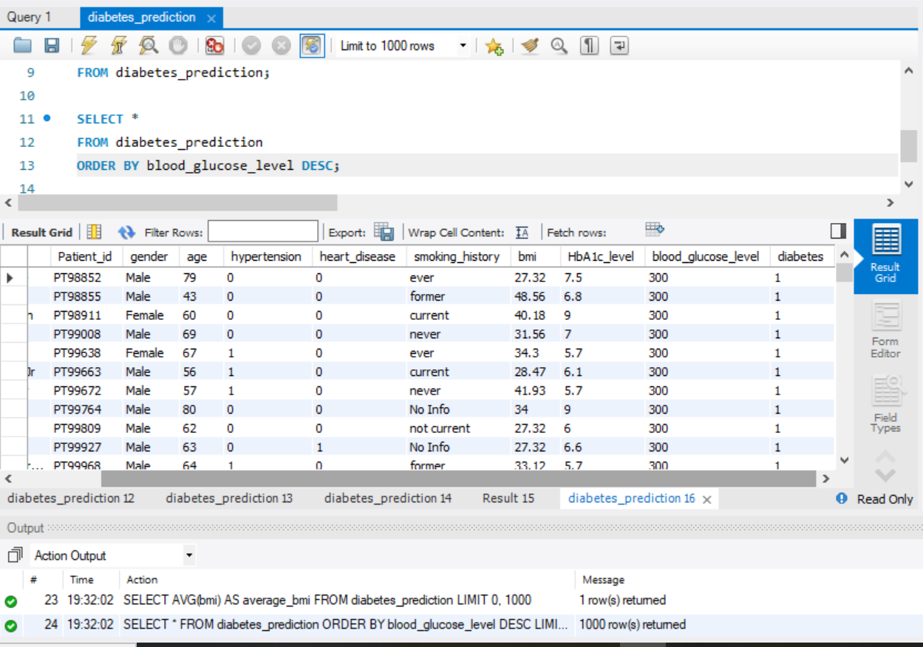
Task- 4 : List patients in descending order of blood glucose level
Please find the below Screenshot of SQL query details performed by using MySQL

Slide 7
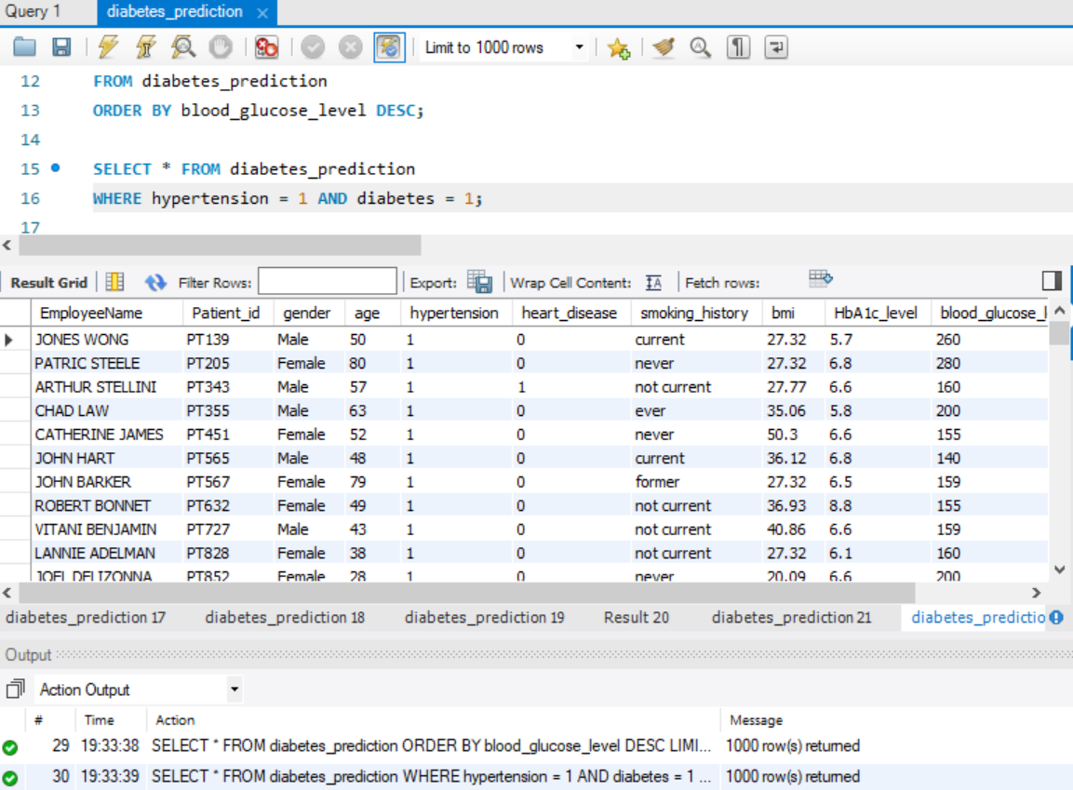
Task- 5 : Find patients who have hypertension and diabetes
Please find the below Screenshot of SQL query details performed by using MySQL

Slide 8
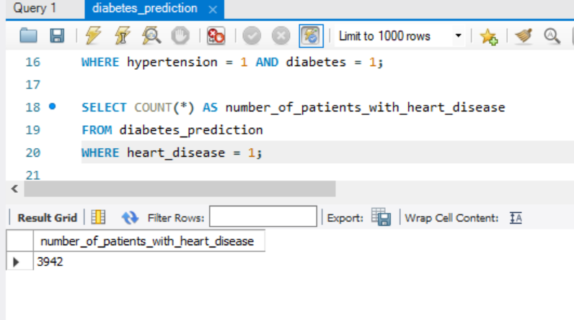
Task- 6 : Determine the number of patients with heart disease
Please find the below Screenshot of SQL query details performed by using MySQL

Slide 9
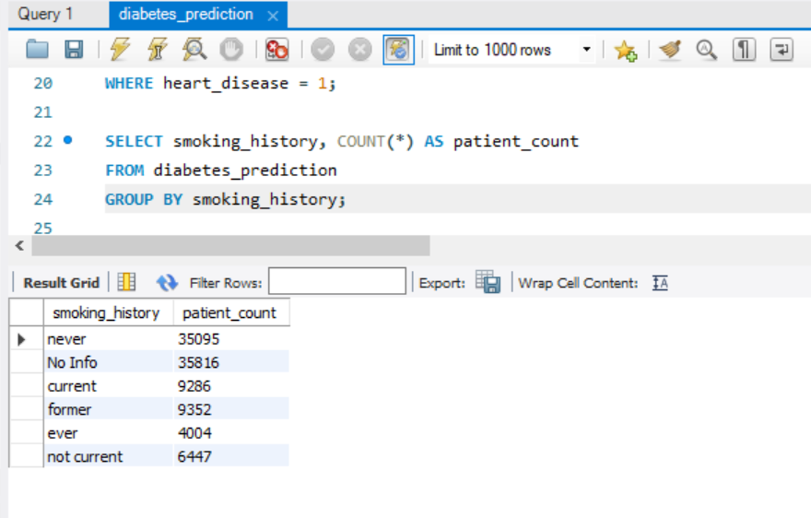
Task- 7 : Group patients by smoking history and count how many smokers and non-smokers there are
Please find the below Screenshot of SQL query details performed by using MySQL

Slide 10
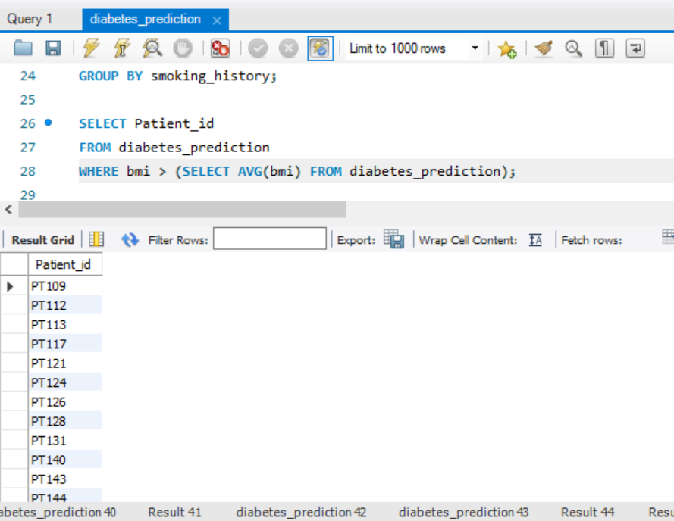
Task- 8 : Retrieve the Patient_ids of patients who have a BMI greater than the average BMI
Please find the below Screenshot of SQL query details performed by using MySQL

Slide 11
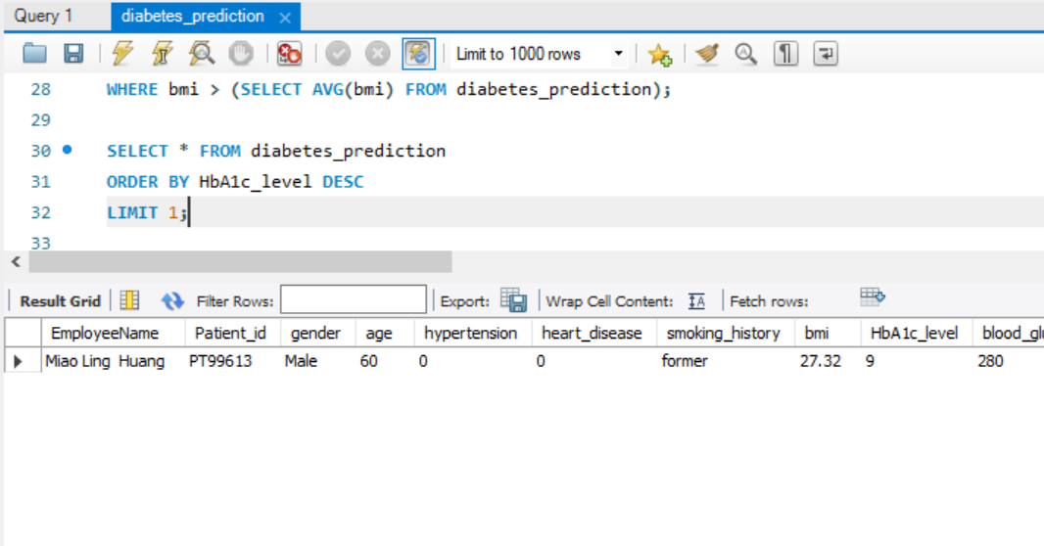
Task- 9 : Find the patient with the highest HbA1c level and the patient with the lowest HbA1clevel
Please find the below Screenshot of SQL query details performed by using MySQL

Slide 12
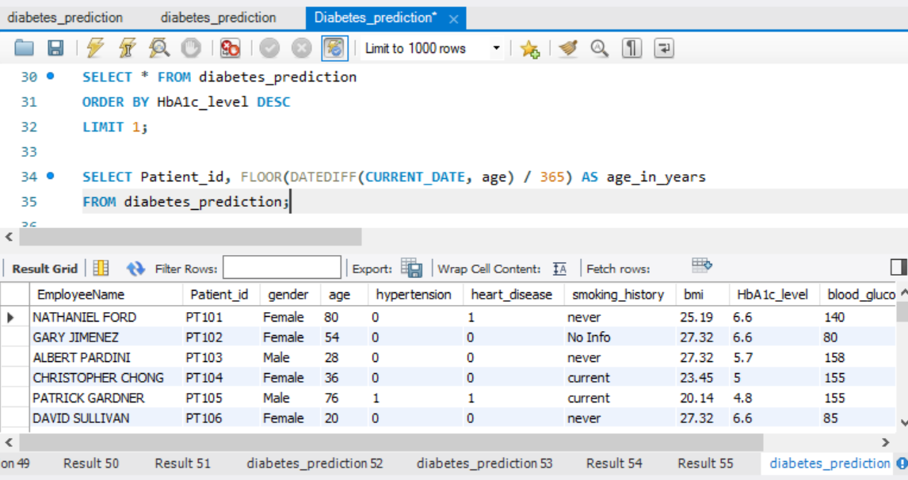
Task- 10 : Calculate the age of patients in years (assuming the current date as of now)
Please find the below Screenshot of SQL query details performed by using MySQL

Slide 13
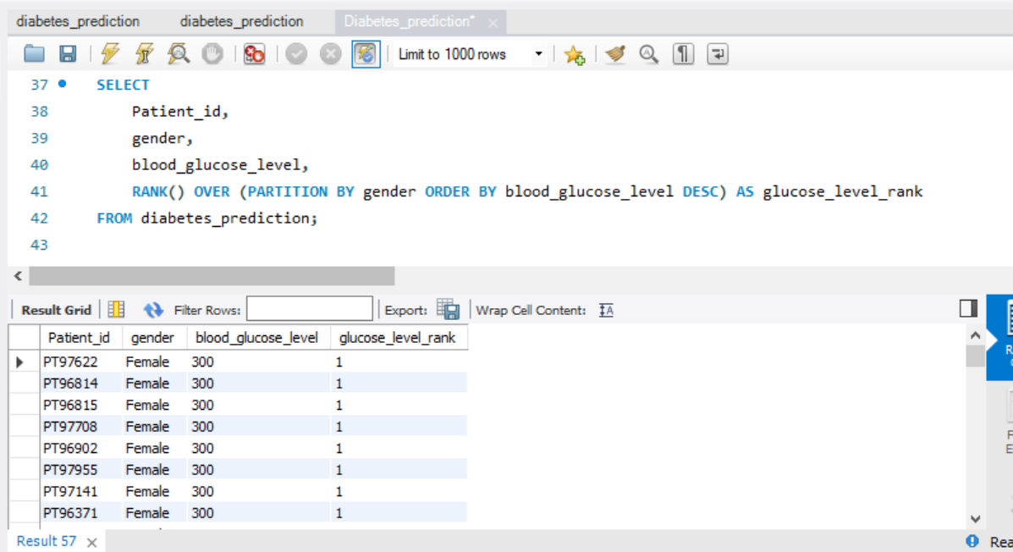
Task- 11 : Rank patients by blood glucose level within each gender group
Please find the below Screenshot of SQL query details performed by using MySQL

Slide 14
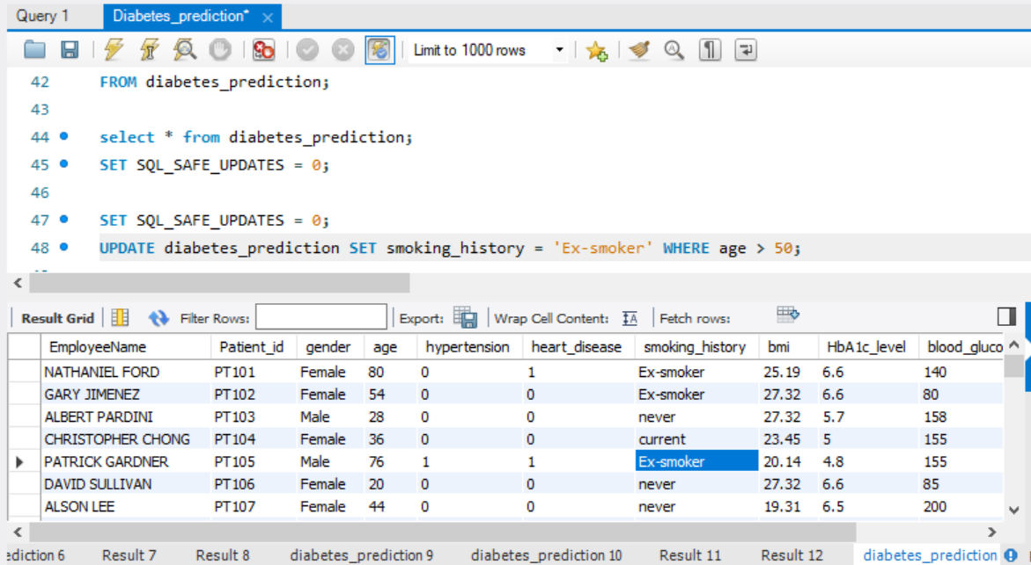
Task- 12 : Update the smoking history of patients who are older than 50 to "Ex-smoker."
Please find the below Screenshot of SQL query details performed by using MySQL

Slide 15
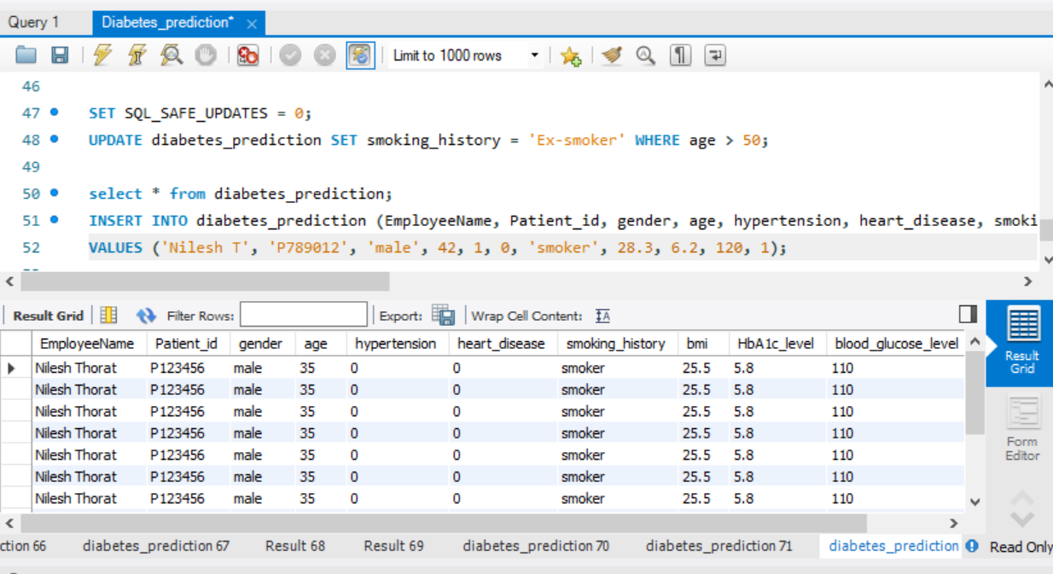
Task- 13 : Insert a new patient into the database with sample data
Please find the below Screenshot of SQL query details performed by using MySQL

Slide 16
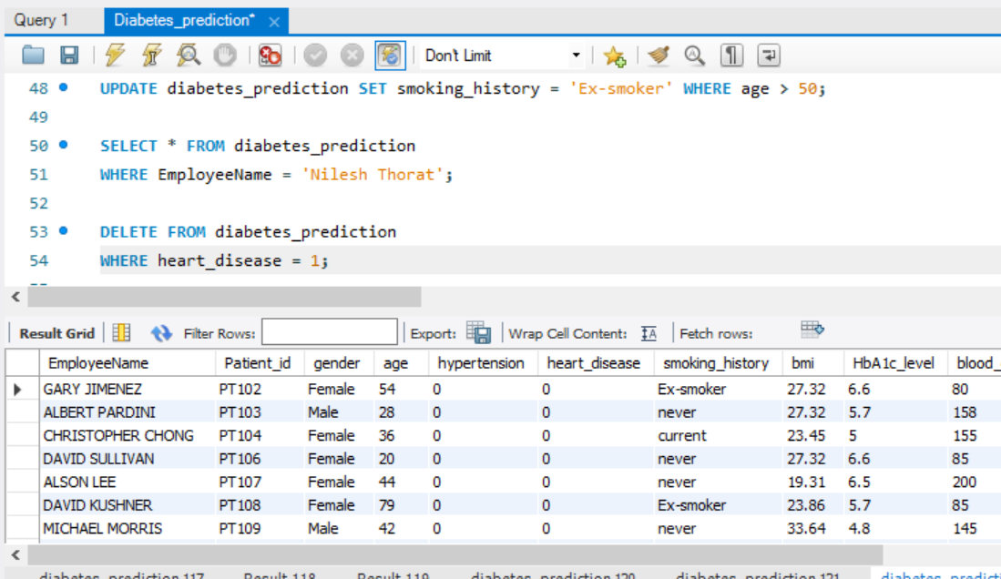
Task- 14 : Delete all patients with heart disease from the database
Please find the below Screenshot of SQL query details performed by using MySQL

Slide 17
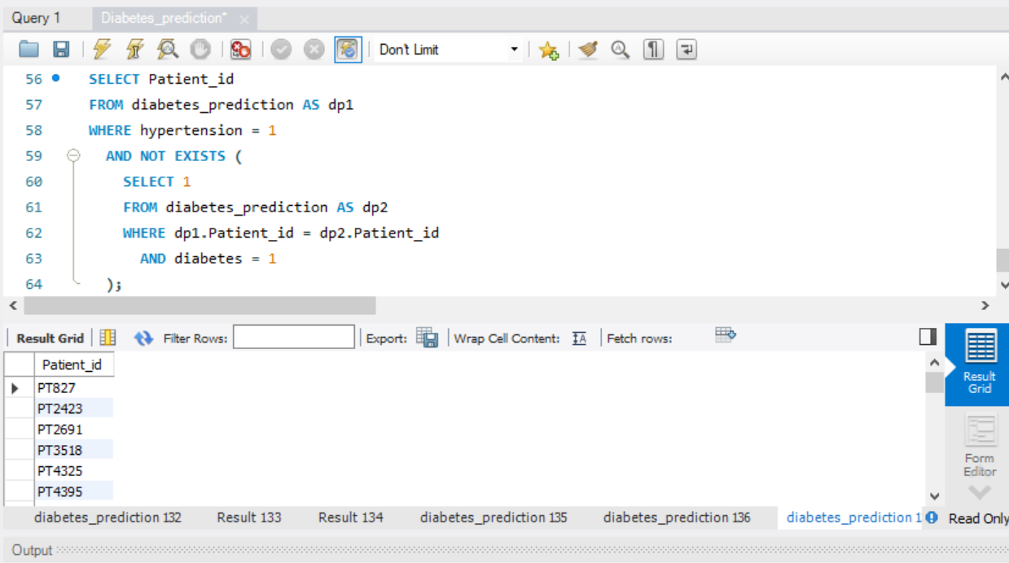
Task- 15 : Find patients who have hypertension but not diabetes using the EXCEPT operator
Please find the below Screenshot of SQL query details performed by using MySQL

Slide 18
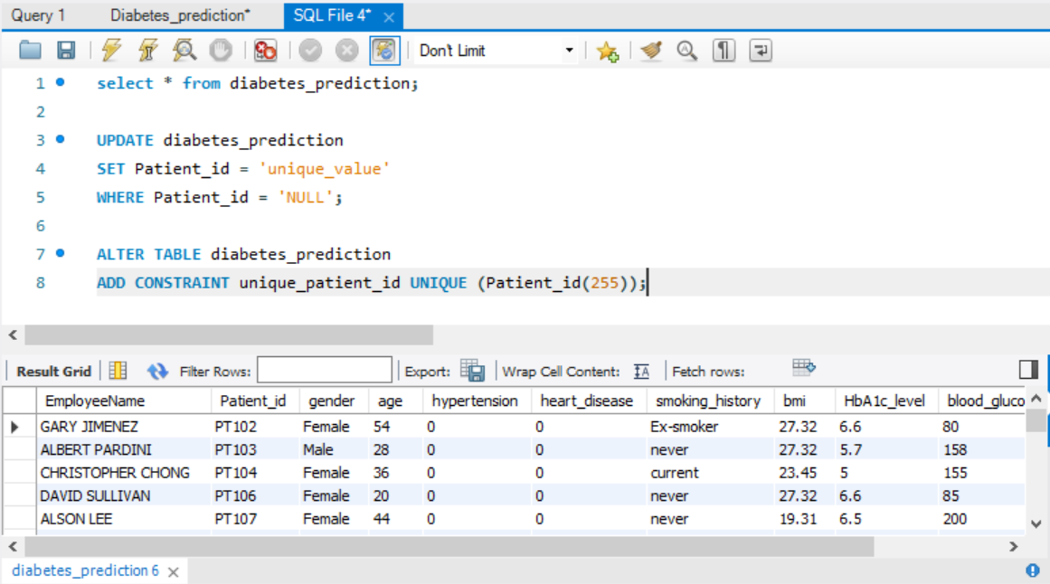
Task- 16 : Define a unique constraint on the "patient_id" column to ensure its values are unique
Please find the below Screenshot of SQL query details performed by using MySQL

Slide 19
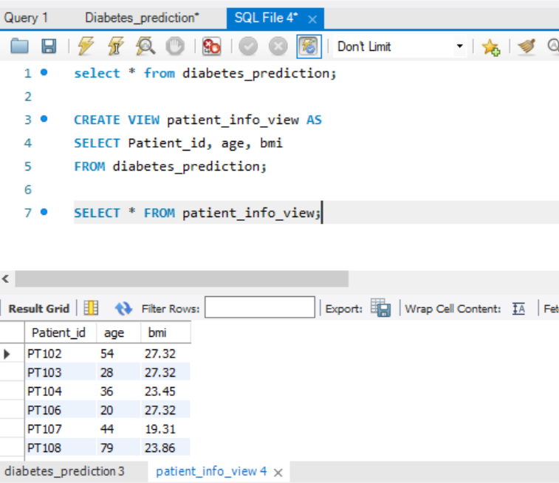
Task- 17 : Create a view that displays the Patient_ids, ages, and BMI of patients
Please find the below Screenshot of SQL query details performed by using MySQL

Slide 20
Task- 18 : Suggest improvements in the database schema to reduce data redundancy and improve data integrity
To enhance the database schema and promote data integrity, consider implementing normalization techniques to eliminate redundancy. Break down large tables into smaller, related ones and adhere to normalization forms like 1NF, 2NF, and 3NF. Utilize appropriate data types for each column to optimize storage and improve data consistency. Employ primary and foreign keys to uniquely identify records and establish relationships between tables, ensuring referential integrity.
Avoid storing derived data and dynamically calculate values when needed. Enforce unique constraints on columns requiring uniqueness, such as patient identifiers. For categorical data, use ENUM types or lookup tables instead of free-form text fields to maintain consistency. Introduce indexes on frequently queried columns for better query performance, but exercise caution to prevent unnecessary overhead. Utilize default values and constraints to uphold data rules and provide timestamps for auditing purposes, enabling effective tracking of record creation and updates. Finally, document the schema comprehensively for clarity and ease of maintenance. Thoroughly test any schema modifications in a development environment before applying changes to a production database.

Slide 21
Task- 19 : Explain how you can optimize the performance of SQL queries on this dataset
Optimizing SQL query performance on the "diabetes_prediction" dataset involves strategic approaches to streamline data retrieval and enhance efficiency. Start by identifying and indexing columns frequently used in WHERE clauses or JOIN conditions, such as "Patient_id" and "blood_glucose_level." Indexing accelerates data access and retrieval speed. When querying, utilize the WHERE clause judiciously to filter only essential information, especially when handling large datasets.
Efficient JOIN operations are crucial for performance. Ensure that join conditions are well-optimized, and consider indexing foreign key columns involved in JOINs. Explicitly list necessary columns in SELECT statements rather than using SELECT * to reduce data transfer and enhance query performance. For batch operations involving updates or inserts, consider batch processing to minimize transaction overhead.
Leverage database-specific query optimization tools and analyzers to identify slow queries and missing indexes. Utilize EXPLAIN statements to analyze query execution plans and address bottlenecks. Adjust database configurations based on workload requirements, considering cache sizes and memory settings. Regularly update statistics to keep the query optimizer well-informed about data distribution and improve decision-making in query planning.
These strategies, tailored to the characteristics of the dataset and specific database system, collectively contribute to optimizing SQL query performance. Thorough testing in a controlled environment is essential to assess the impact of optimizations before applying changes to a production database.

Slide 22
Data Analyst : Nilesh Thorat Email : nilesh.thorat01@gmail.com Linkedin: www.linkedin.com/in/nileshthorat
Thank You

